Slide 1
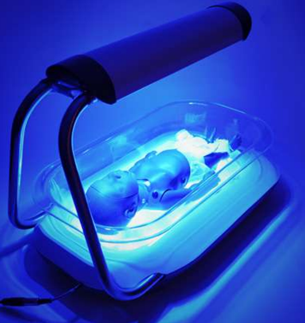
Phototherapy unit
principles of operation
function
use
scientific principles
construction
components
system diagram
inputs/outputs
troubleshooting
identifying common faults
replacing components
rectifying faults
safety considerations
user and patient safety
electrical safety
18.3.2 Maintain a phototherapy unit
Unit C18.3 Maintaining Paediatrics Equipment
Module 279 19 C Medical Instrumentation II
©
dr. Chris R. Mol, BME, NORTEC, 2015

Slide 2
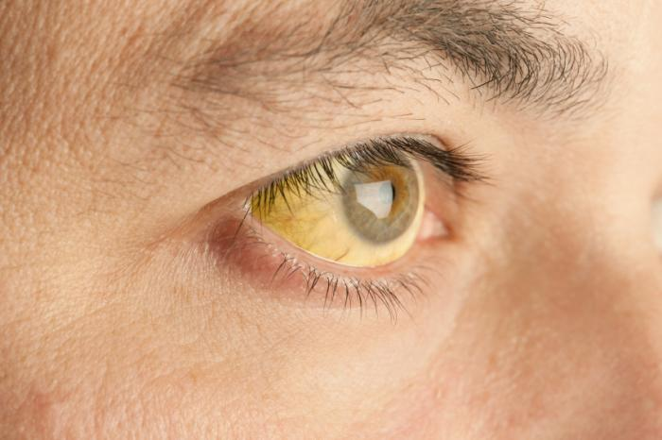
Hyper-bilirubinemia
A phototherapy device is used to treat hyper-bilirubinemia, a disease which often occurs in babies and is characterized by high bilirubin concentrations in the blood.
Bilirubin is a normal, yellow, product of hemoglobin breakdown, caused by the body's clearance of aged red blood cells which contain hemoglobin. It remains in the body until the liver converts it to a form that can be excreted.
Bilirubin is excreted in bile and urine, and elevated levels may indicate certain diseases. It is responsible for the yellow colour of bruises and the yellow discoloration in jaundice.
Jaundice, a yellowish discoloration of the skin, eyes, and mucous membranes, results when bilirubin levels in the blood are too high. High bilirubin levels can be caused by the inability of an immature liver to process high levels of bilirubin, particularly in neonates.
©
Phototherapy unit
dr. Chris R. Mol, BME, NORTEC, 2015

Slide 3
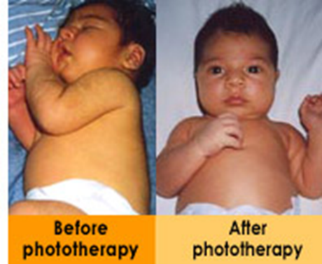
Phototherapy
Neonatal jaundice or Neonatal hyperbilirubinemia (too high bilirubin level) is a yellowing of the skin and other tissues of a new-born infant. Jaundiced new-borns have yellow discoloration of the white part of the eye, and yellowing of the face, extending down onto the chest.
This condition affects up to 60% of all babies in the first week of life; most of these are ‘normal’ and do not require treatment.
Neonatal jaundice can make the new-born sleepy and interfere with feeding.
Jaundice may be normal or abnormal:
It is normal (‘physiological’) if the skin and eyes yellow but there are none of the signs of abnormal jaundice below.
It is abnormal (non-physiological) if
it starts on the first day of life and lasts > 14 days in term and > 21 days in preterm infants
if it is accompanied with fever
Extreme jaundice can cause permanent brain damage.
Abnormal jaundice may be due to a multiple causes including bacterial infection or liver disease.
©
Phototherapy unit
dr. Chris R. Mol, BME, NORTEC, 2015

Slide 4
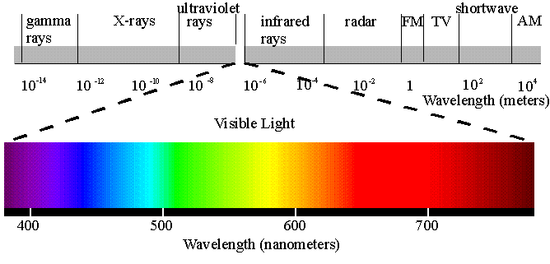
Phototherapy
Visible light, specifically the blue-light wavelengths of approximately 420 to 500 nanometres, photo-chemically reduces bilirubin to water-soluble products that can be excreted.
By exposing patients to light of this wavelength range, hyper-bilirubinemia can be treated.
The blue light can be applied
with overhead lamps, which radiate the blue light or
with a device called a Bili-blanket, which uses fiber optic to guide the blue light to the babies skin.
©
Phototherapy unit
dr. Chris R. Mol, BME, NORTEC, 2015

Slide 5
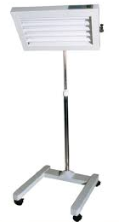
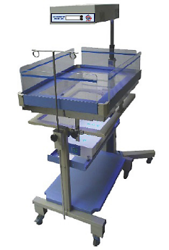
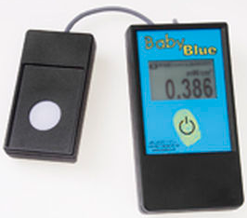
Overhead Lamps
Devices using overhead lamps can be freestanding on casters, ceiling or wall mounted, or attached to infant radiant warmers or infant incubators; some units have height and hood angle adjustments.
Bassinet-style units, in which the infant is placed in a plastic bassinet containing a bank of lights in an overhead case, are also available.
Irradiance level is controlled by
light-intensity switches and
by the distance between the light source and the patient. (Decreasing the distance between the patient and the light source increases the irradiance level.)
Free-standing
Bassinet-style
A radiometer with an appropriate bandwidth can be used to measure the irradiance that reaches the patient during phototherapy.
©
Phototherapy unit
dr. Chris R. Mol, BME, NORTEC, 2015

Slide 6
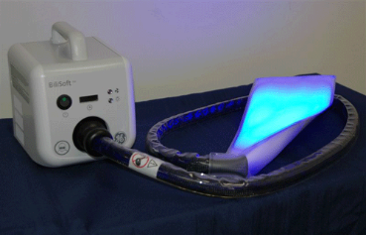
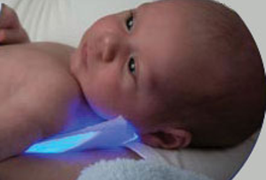
Pad systems
Fiber-optic phototherapy pad systems, also called bili-blankets, use a tungsten-halogen bulb in a metal case, a flexible fiber-optic cable, and a light-emitting plastic pad, usually 25cm x 13cm.
Filtered blue light is delivered from the source through the fiber-optic cable and emitted from the sides and ends of the fibres inside the pad, which is wrapped around the infant.
Bili-blankets offer the possibility of treating some degrees of jaundice at home as long as the baby is otherwise healthy. This makes these devices quite popular with parents, doctors and insurance companies, who would otherwise have to pay for more expensive inpatient treatment.
©
Phototherapy unit
dr. Chris R. Mol, BME, NORTEC, 2015

Slide 7
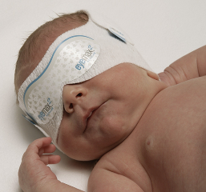
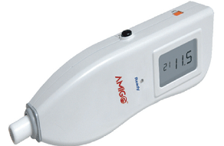
Use
An eye mask is placed on unclothed infant and the infant is placed in the bassinet. This is to prevent damage to the infant’s retina (eyes) from the ultraviolet light.
Depending on configuration, the lamp distance is set depending on intensity of therapy desired, or the infant is wrapped in fiber-optic pad.
Treatment typically lasts 1-3 days.
baby with eye mask
neo-natal jaundice meter
©
Phototherapy unit
dr. Chris R. Mol, BME, NORTEC, 2015

Slide 8
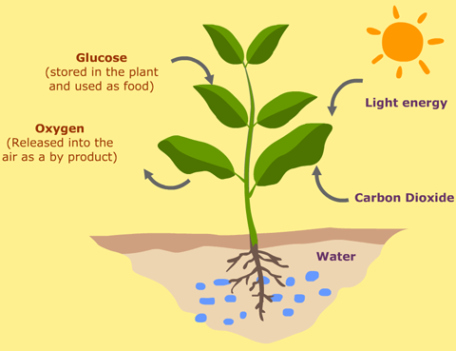
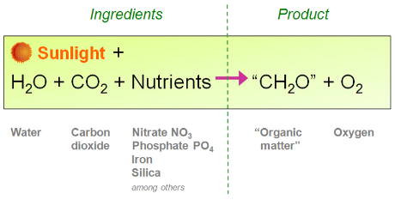
Scientific Principles: photo-chemical reactions
Photo-chemistry is the branch of chemistry concerned with the chemical effects of ultraviolet radiation, visible light or infrared radiation.
A photo-chemical reaction is a chemical change induced by light. An example is photosynthesis, where sunlight is absorbed by plants (leaves) and provides the energy to help the plant grow.
photosynthesis
©
Phototherapy unit
dr. Chris R. Mol, BME, NORTEC, 2015

Slide 9
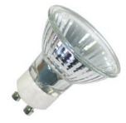
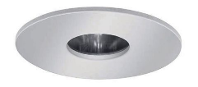
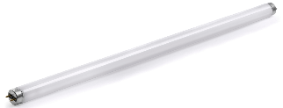
Components: light sources
Emitted light should be filtered to remove harmful infra-red and ultraviolet radiation. Light should be focused on the baby.
Halogen spotlights
Spotlight phototherapy units generally use a 150 Watt, 21V halogen bulb with a specially coated reflector which absorbs infrared wave length. A fan continuously cools the hot bulb. Options for varying aperture diameter and different filters are available. Positioning of the light on the baby is critically important in maximizing the spotlight’s effectiveness. They are most effective when located directly above the infant at a distance of 45-50 cm.
Florescent lamp devices
These have optimized blue light emission at 400-520 nm wavelengths. Special blue fluorescent are labelled F20T12/BB or TL 20W/52. If possible, the irradiance should be measured at regular time intervals to ensure that an adequate dose is being delivered. Fluorescent tubes lose about 35-40% of blue light irradiance after 1200 hours of use. These lights can provide an irradiance of >25-30 W/cm2/nm in the 400-520 nm range when placed closely, thus making phototherapy maximally effective particularly when the greatest body surface area is exposed.
©
Phototherapy unit
dr. Chris R. Mol, BME, NORTEC, 2015

Slide 10
Components: light sources
Fiber-optic pads
These devices use plastic fiber-optic light guides to deliver light from a halogen lamp to illuminate a (bili-)blanket or pad which is wrapped around or placed under the baby. These devices deliver light in the 400 to 550 nm spectral band. The pad is cool and can be placed in direct contact with the baby. They can be used as an auxiliary light source to increase the surface area exposed or as the sole source of phototherapy, particularly in preterm infants. In recent models, the halogen light source has been replaced by high intensity high power LED bulbs. This increases the irradiance delivered by the pads.
Compact fluorescent tubes
These are short (approx. 5 to 7 inch) double folded tubes (9-18 Watts) that emit blue or white light. Several tubes (6-8) are housed in a panel with reflectors. As they do not produce much heat the distance to baby can be relatively short thus increasing the irradiance delivered. Most of them produce an irradiance of 20-30 W/cm2/nm when placed close to the baby.
Light emitting diodes (LED)
Blue LED devices emit a narrow spectrum that overlaps the absorption spectrum of bilirubin. They are power-efficient, portable devices with low heat production that can be kept close to the baby. They are durable and long lasting with low power consumption.
©
Phototherapy unit
dr. Chris R. Mol, BME, NORTEC, 2015

Slide 11
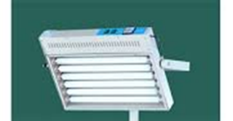
Filtering UV-light
Depending on the light source used, filters need to be placed in front of the lights, to absorb the ultraviolet radiation that is emitted by the light. This can be done by (transparent) Plexiglas which is often mounted in front of the lights, e.g. in the case of fluorescent lights.
Sometimes a white light is built into the unit to facilitate observation of the baby. It is difficult to observe the baby’s color under blue light. This white light may have a timer to be automatically be switched of after a number of seconds.
We skip the system diagram since this unit is not more complex than of any (set of) lamps, possibly with a timer.
©
Phototherapy unit
dr. Chris R. Mol, BME, NORTEC, 2015

Slide 12
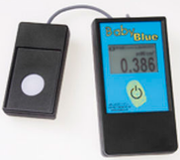
Preventive Maintenance
If possible, use a spectro-radiometer to measure the irradiance and replace the tubes or halogen light sources with new bulbs if the irradiance has fallen below 10-12uW/cm2/nm or to two thirds of its original value.
It is not necessary to measure irradiance before each use of phototherapy; but it is important to perform periodic checks of phototherapy units to make sure that an adequate irradiance is being delivered.
If a spectro-radiometer is not available, halogen bulbs and fluorescent tubes should be changed every 1200 hours or 3 months of intermittent use, whichever is earlier, or when fluorescent bulbs flicker or tube ends blacken. Maintaining a logbook for duration of use or built-in timer in the device is useful. Keep bulbs and reflectors dust free and do not cover the unit with cloth, charts or files as this will prevent circulation of air and heat the bulbs.
Most hospitals do not have a flux-meter to measure blue light output of phototherapy unit. We must remember that the phototherapy unit is not just a source of a visual illumination. It is biomedical equipment which needs to be serviced by a trained and knowledgeable person.
Ensure that the supplier of the unit has a flux-meter with him and checks the efficiency of the phototherapy unit periodically.
The most common problem is a broken or missing light bulb. There is little else that can go wrong.
©
Phototherapy unit
dr. Chris R. Mol, BME, NORTEC, 2015

Slide 13
Preventive Maintenance
Always disinfect and clean the unit and accessories before any maintenance
disconnect power supply before maintenance
use original parts for maintenance
periodically check the insulation and the cable connection
check the temperature measuring system
©
Phototherapy unit
dr. Chris R. Mol, BME, NORTEC, 2015

Slide 14
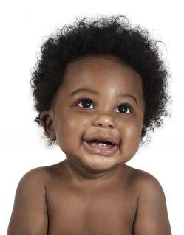
Safety Considerations
Ultraviolet (280 to 400 nm) or near-infrared (780 to 1,400 nm) radiation must be filtered because at high enough levels, both types of radiation can damage the eyes and skin.
Known common side effects of phototherapy include changes in body temperature, insensible water loss, and diarrhoea.
With fiber-optic units, a blanket can be wrapped around the infant and fiber-optic pad to minimize fluctuations in body temperature.
Using the wrong replacement tubes may result in ineffective phototherapy and may expose infants to excessive UV or IR irradiation, causing overheating and burns.
UV radiation is associated with such adverse effects as erythema and skin tanning, which can contribute to skin cancer. In addition, overheating can cause dehydration and complicate other conditions.
If tubes other than those specified by the manufacturer are to be used, verify with a radiometer that they are appropriate (transmit light in the right frequency range).
©
Phototherapy unit
dr. Chris R. Mol, BME, NORTEC, 2015

Slide 15
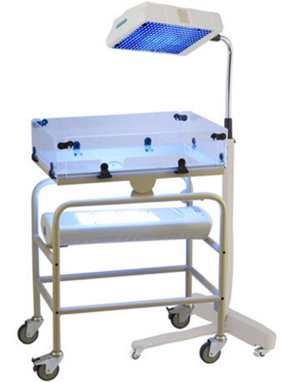
Competitive Features
©
Phototherapy unit
dr. Chris R. Mol, BME, NORTEC, 2015

Slide 16
END
The creation of this presentation was supported by a grant from THET:
see https://www.thet.org/

